Slide 1
Alloys and Their Uses

Slide 2
By the end of this lesson you should be able to:
Define and describe alloys.
Explain how the properties and structure of alloys differ from pure metals.
Explain why alloys can be more useful than pure metals.
Identify some alloys.

Slide 3
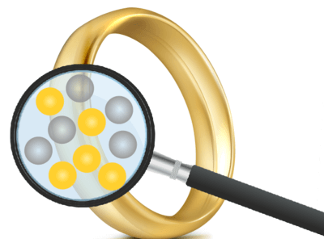
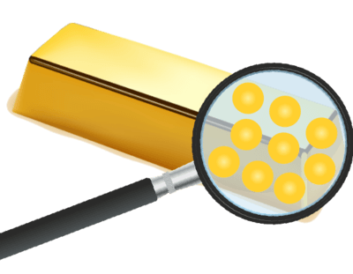
Most metals aren’t very useful in their pure form, because they are either too soft, too brittle or too reactive.
Alloys are a mixture of a metal with another element, either a metal or non-metal.
Combining metals with other elements changes the properties of the metals to give them desired characteristics necessary for specific uses.

Slide 4
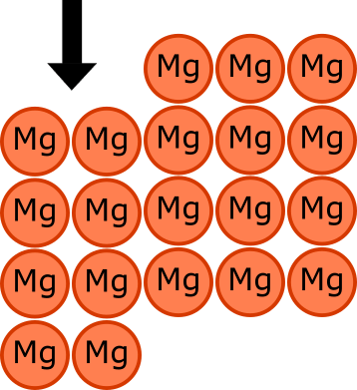
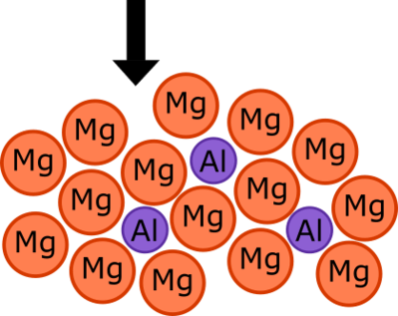
The atoms in pure metals are all the same size. This allows the rows of metal atoms to easily slide over each other when enough pressure is applied. This means that pure metals are usually soft and malleable.
When a metal is combined with another element, the two different elements will have different sized atoms. This means that the layers of atoms won’t slide over each other and the alloy is harder than the individual metals.

Slide 5

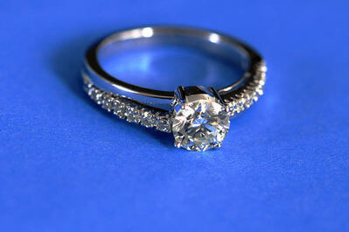
As well as being harder than pure metals, alloys can have a number of advantages over pure metals depending on the combination of metals used.
For example, alloys may be stronger, less reactive or have a different melting point than pure metals. Alloys may also be used to increase the lustre or change the colour of a metal.

Slide 6
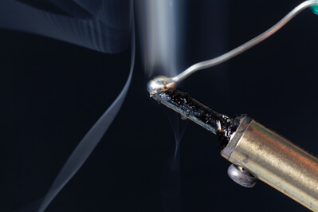
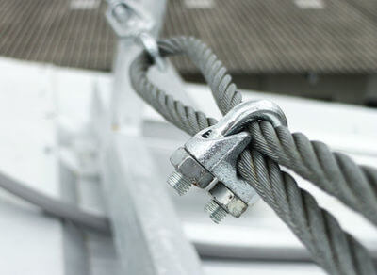
The properties of the alloy may be different to the properties of the elements it contains. Like in the example of gold jewellery, gold, silver and copper are all soft metals in their pure form but an alloy of all three is harder.
Alloys made of the same elements can have different properties depending on the percentage of each element that is used.

Slide 7

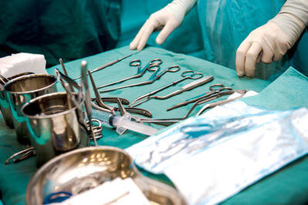
Steel
Steel is an alloy of iron and carbon that is much stronger than iron. It has many uses including buildings, infrastructure, transport and machinery.
Chromium is a very lustrous metal. It is added to iron and carbon to make stainless steel, which has a number of uses, especially in the food and beverage industries.

Slide 8
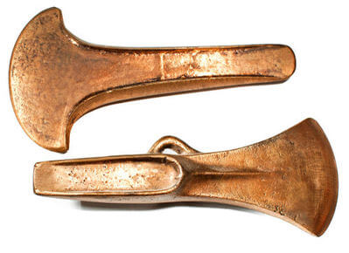
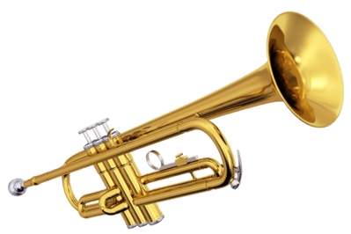
Copper Alloys
Bronze is an alloy of copper and tin. There are lots of different bronzes but typically around 88% copper and 12% tin is used. Before stainless steel, bronze was used in boats and ships because of its hardness and resistance to salt water corrosion.
Brass is an alloy of copper and zinc, it is more malleable and has a slightly lower melting point than bronze. This makes it useful for use in instruments such as trumpets and horns.

Slide 9


Aluminium Alloys
Duralumin is an aluminium alloy containing around 4% copper and small amounts of other metals. The addition of copper to aluminium makes the alloy stronger but still lightweight and malleable. This makes it ideal for use in aeroplanes and cars.
Magnalium is an alloy of 95% aluminium and 5% magnesium. Magnalium is stronger but also has a lower density than pure aluminium. This alloy is also used in aeroplane and car parts.

Slide 10
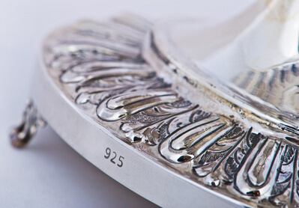
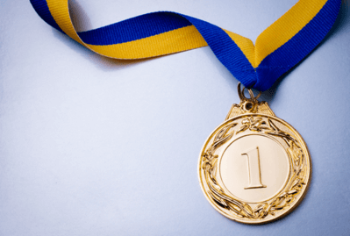
Silver Alloys
Sterling silver is made of 92.5% silver and 7.5% other metals, usually copper. Sterling silver is harder than pure silver so it can be more useful in a range of decorative applications.
Sterling silver has also been used in cutlery, dishes and even medical instruments. However sterling silver is more expensive and tarnishes easily so these uses are less common today.
Electrum is a naturally occurring alloy of silver and gold that was used in ancient coins as it is harder and more durable than pure silver and gold.

Slide 11
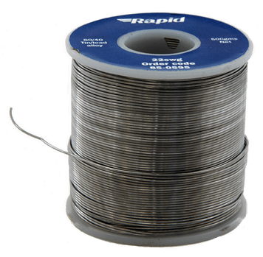
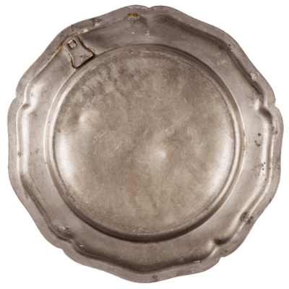
Tin Alloys
Tin is a soft, lustrous metal. About half of all tin that is produced is used in solder. Solder is an alloy of tin and lead and is used to join metals together.
Solder has a low melting point which ensures that when the solder is melted to join the metals components, the other metals won't also melt. Solder used in electronics also needs to have good electrical conductivity.
Pewter is another tin alloy which is combined with copper or lead. The addition of copper or lead makes the tin harder. Pewter is mainly used in decorative objects but historically it is has been used for serving dishes and cutlery.

